Slide 1
Social Media Analysis
Project 2, Step 2
By Presenter Rihem Maaref

Slide 2

Chosen Company
Carrefour is a multinational retail firm based in France.
It owns and manages a hypermarket, grocery store, and convenience store network with 12,225 locations in over 30 countries.

Slide 3
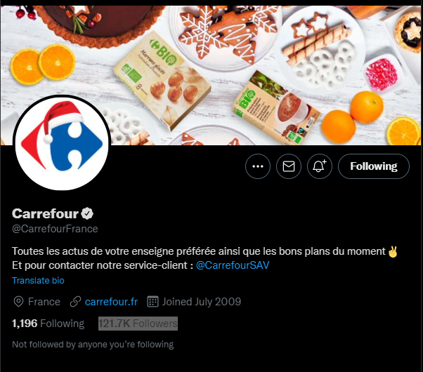
Carrefour Tweeter
@CarrefourFrance
Carrefour

Slide 4
Tools
7
Gephi

Slide 5
Measures
Degree : that an important node (user) will have many connections.
Closeness : that important nodes are close to other nodes
Betweenness : that important nodes are well situated and connect other nodes.
Eigenvector shows us which node is the most influencer

Slide 6
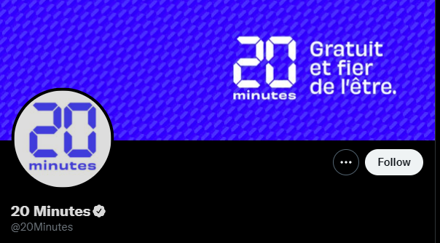


Influencers

Slide 7
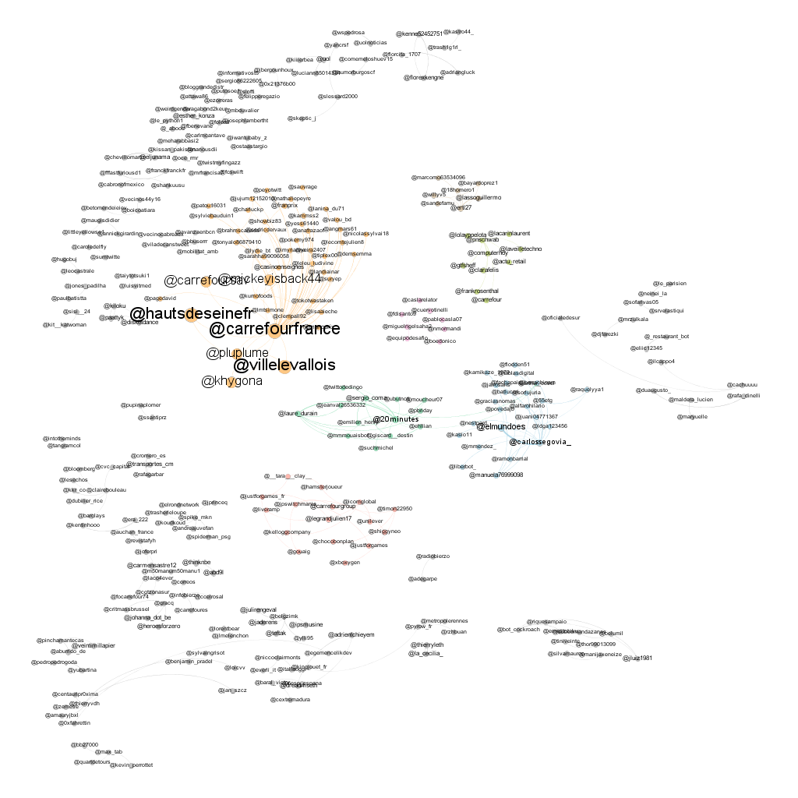
Graph

Slide 8
Problems
Couldn't get a developer account to use tweeter API
Tried to work with Tweepy to get the data, but again no tweeter dev account
Couldn’t have the data of last month in Gephi

Slide 9
Thank you

